Slide 1
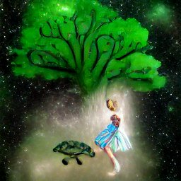

Slide 2
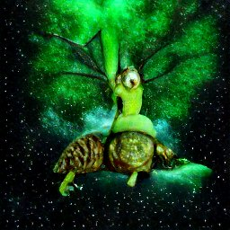

Slide 3
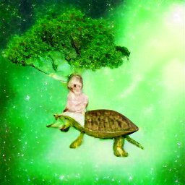

Slide 4
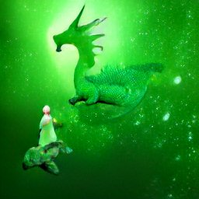

Slide 5
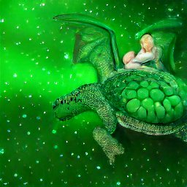

Slide 6
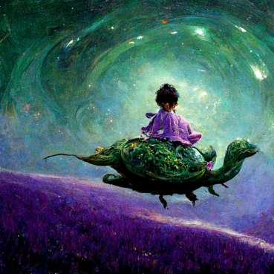

Slide 7
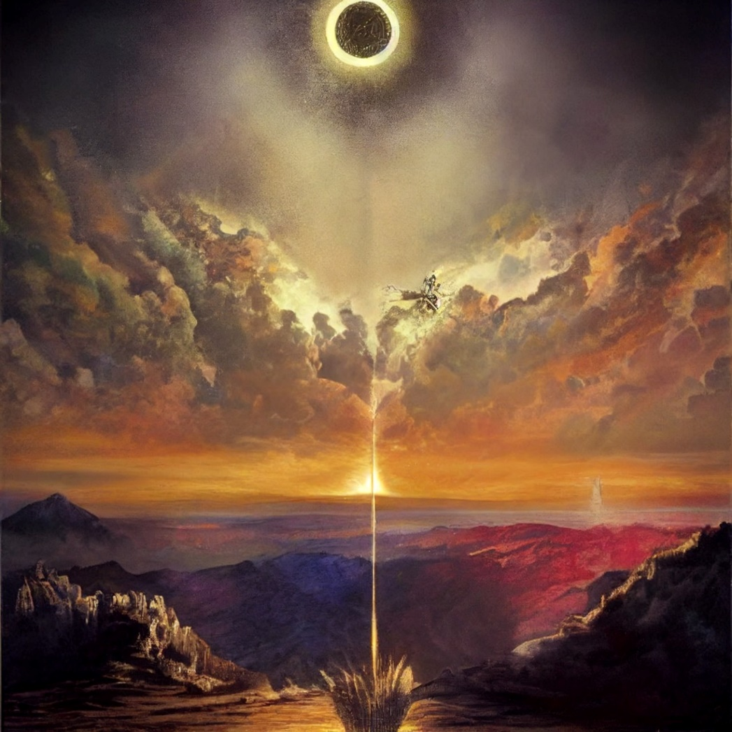
The world was created by a flying turtle or shelled dragon.
The turtle dragon had a rider, a young girl that helped him in the creation of the realm.
The wise creator was an expert gardener, and decided, with the counsel of his rider that the he should seed light in the heart of reality, and darkness in the outer rims of existence.
Thus, was created Tharnir, land of the Free People, and many other creatures. With same amounts, seasons of spring and wither would came to be.

Slide 8
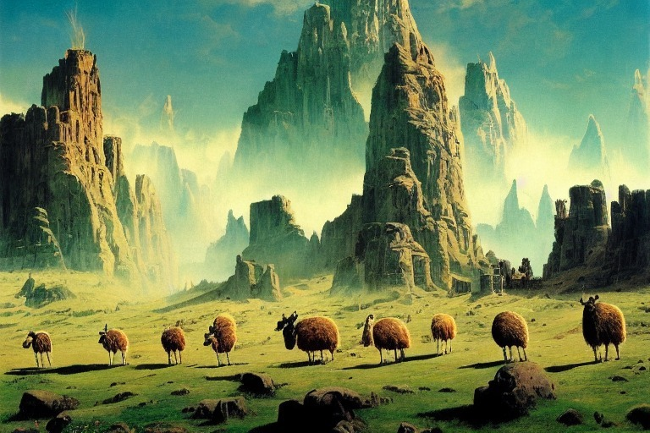
Tharnir was a great land, and no map could hold the entire terrain, for its material was the same of the dreams, therefore being eternally created with almost no limits to its expansion.
Great Peaks and high mountains were the place where the free people choose to inhabit.
Lowerlands had many kind of life, some that was hunt, some that was herd, and even some that predate weak or fool villagers of the free towns.

Slide 9
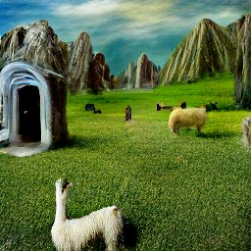
In a lost ground of extreme altitude, it resides an old stone doorway that descends very deeply.
It is said that it can be accesible only by dreams while one is already dreaming, and only that way it is possible to submerge in the long stairs that lead to the capital of the free folk.

Slide 10
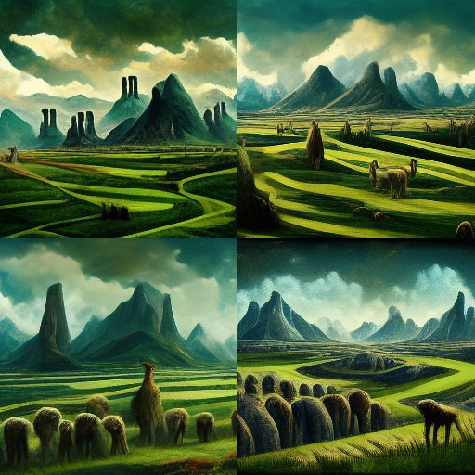
Tharnir, the capital of the Free People, can be seen from very far away, but is almost unaccessable.
From each of the cardinal points, it is posible to behold ancient towers that are rooted to the highest mountains of the valley.
No dangers of beasts can exist around the great city of Tharnir.
The light brights once a day, and darnkess reigns after the former collapses.

Slide 11
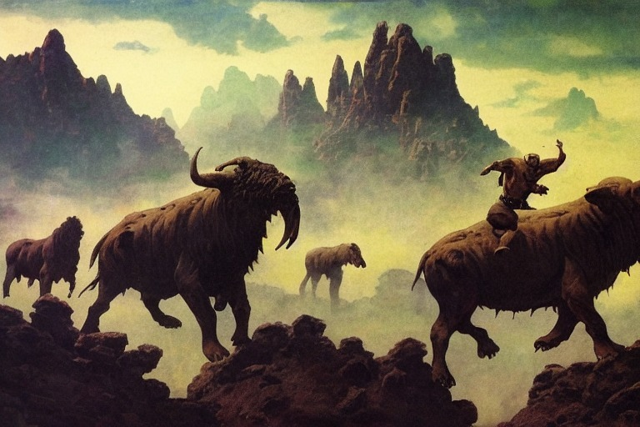
The inugadar are noble and fierce beasts, that were one of the first difficult domestication tasks for the free people.
Some can be mounted, as long as the inugadar knows the gentle thoughts of its rider.
This can be very usefull in the rough geography, for the noble beasts are able to step in the thin air, and climb where no free man or woman could get by the self.
When they are hungry, the horns of the inugadar turns into gaseous and floating waves, which restore as soon as they feed. They eat new ideas that are imagined in the night cooked by the midday sunlight.

Slide 12
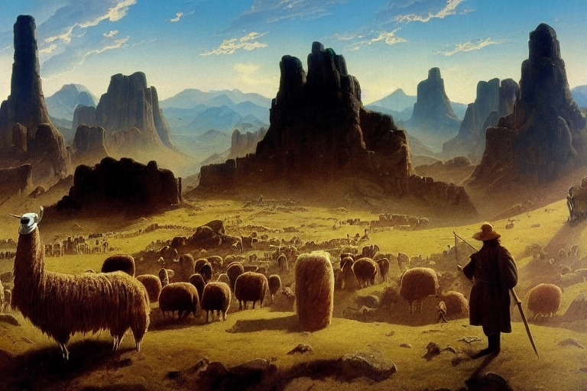
In the outskirts of Tharnir, there are many herders, pastors and animal pshycologist. They live in great houses surrounded by open fields that the rain makes grow with no cease.
Sometimes big campfires are needed to keep away the flying birds that take from the free people they beloved animals.

Slide 13
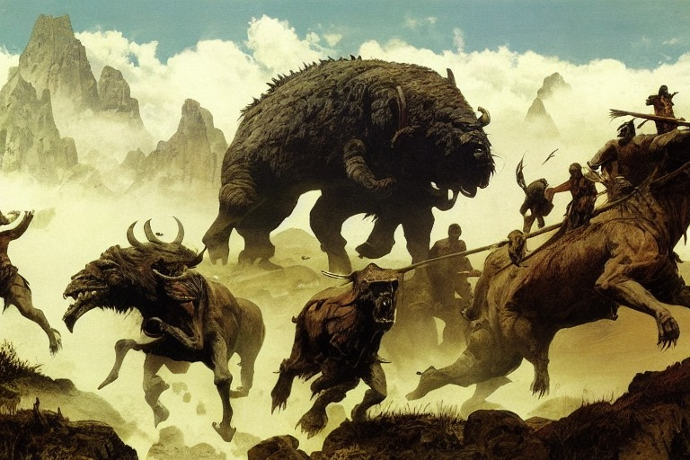
There are ocassions when the strong inugadars are chased by mighty creatures from the underground caverns.
Such is the case of the feral tardigrades, whose skin is so thick that it can break the strongest of the lances.
No feral tardigrade has ever been beaten, and it is unknown the origin of these foul creatures. It is only rumoured that as soon as they are fed, they sunk into great chasms of rocky walls.

Slide 14
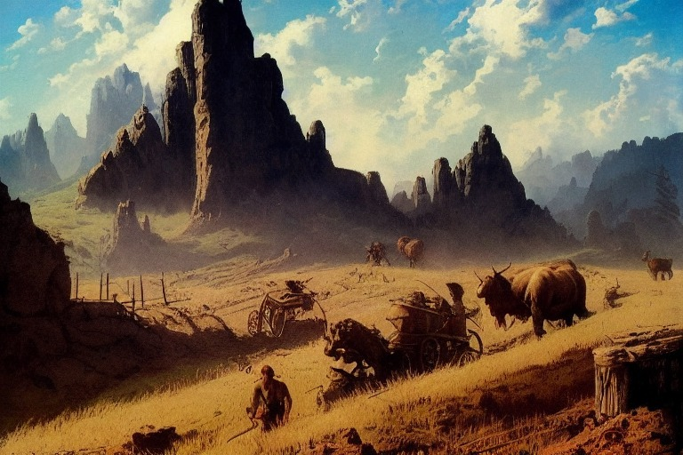
As the outskirts of Tharnir are dangerous, the free folk and its animals need to keep an eye on the predators.
They need to move quickly and stay perceptive. This is good because this thread makes them to want always to be better, so they can live longer as a specie, not as individuals.

Slide 15
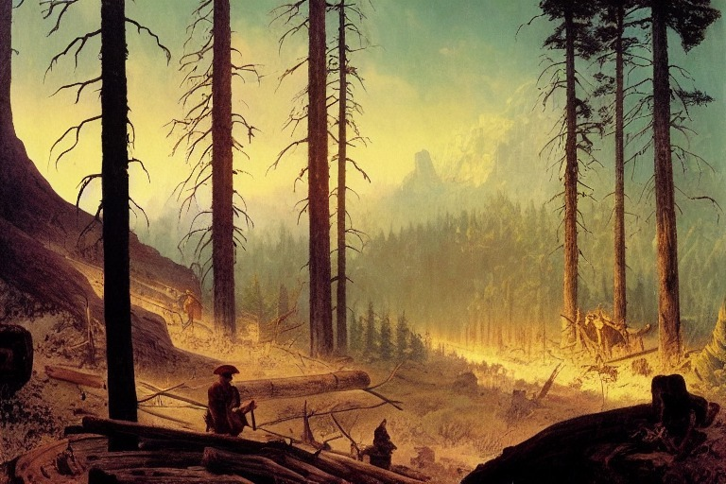
Woodcutting was once practiced, but it took not a long time for the free people to change its manners.
Now they only pick the wood that has fallen by itself and restrict the use of axes to the real enemies of its kind.
Some trees are said to talk, but most of them doesnt feel like forgetting the savagery of ancient free people. They cant trust them because they are made with good and evil in equal parts, and one can really never know.

Slide 16
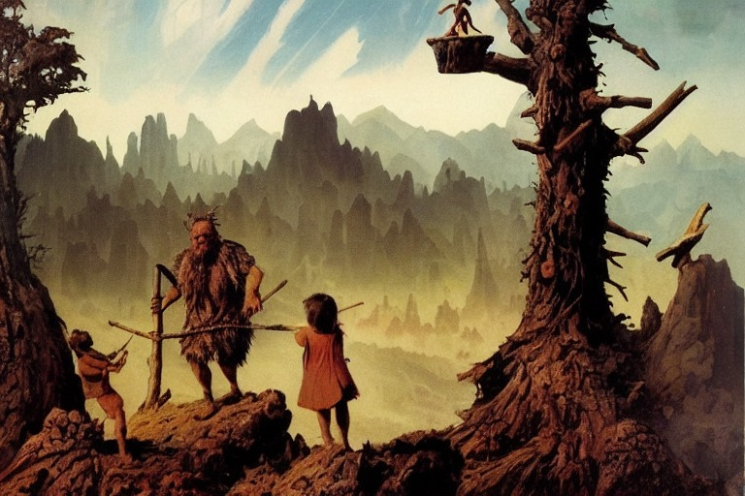
The little kids of the free people like to roam in the wilderness, exploring the world in the places that no one has ever been or seen before.
They tell about strange races of people, who speak a different language, but not an adult ever has believed this.
The items that proves this is real, are the logs cutted by axes, which the free folk dont use on trees at all. How else, then, could the children found these artifacts?

Slide 17
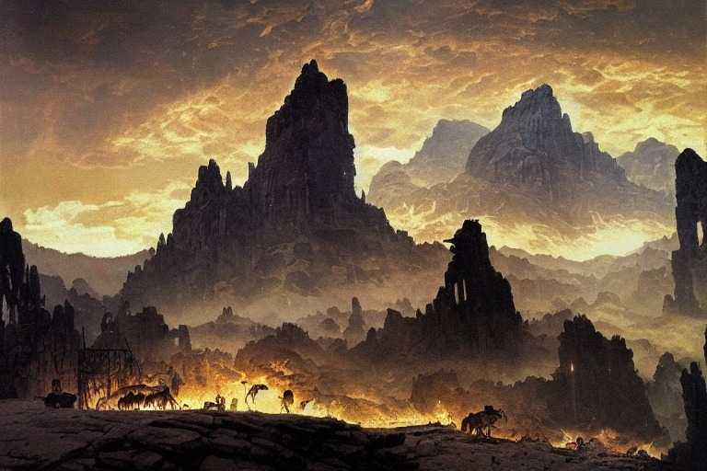
As darkness comes and the night begin its reign, no stars yet are to be seen in the sky. Some forests glow with a strong shine, some mountains are lit with fires at the top, but the most strange lights comes from the chasms.
In great caverns submerged and broadly opened in the rocky walls of the fault, music and shouts can be heard. The effusive lightnings from inside are not so often perceived, for they wait until the darnkess is set to live their lives. Thats way they are called the night people.

Slide 18
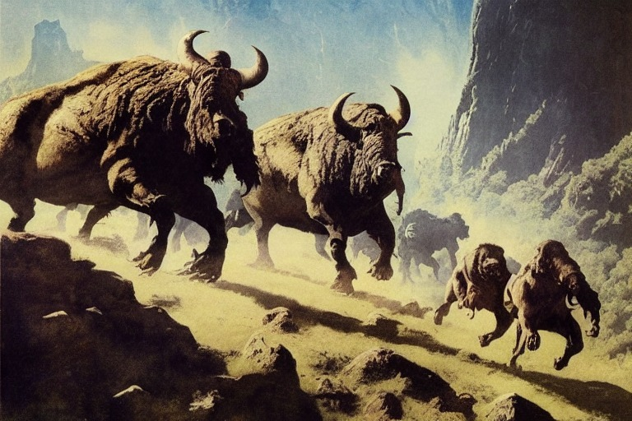
Centaur bulls have six legs and feed themselves with rotten trees, but they like to hunt derivags for sport.
They collect the specimens and smell its rests until they feel like sleeping again. The centaur bulls have no ears, but instead, they sense the frequency of sounds by reverberation. This is why the night and free people know that if you encounter some centaur bulls, the best you can do is remain still and breath quietly.

Slide 19
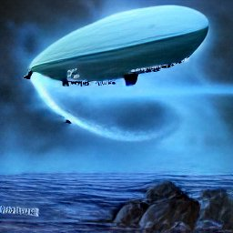

Slide 20
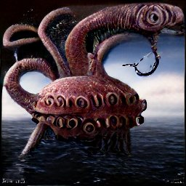

Slide 21
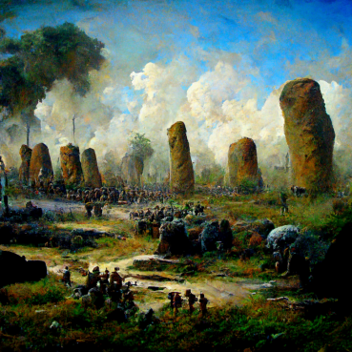

Slide 22
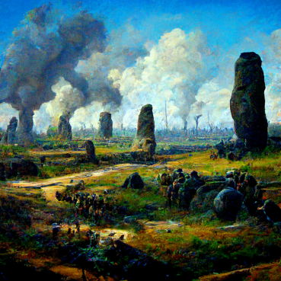

Slide 23
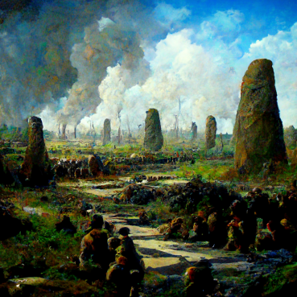

Slide 24
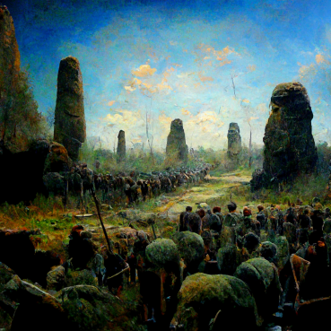

Slide 25
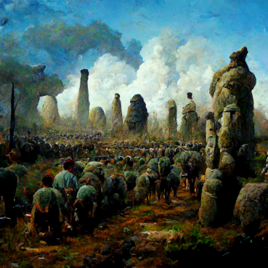

Slide 26
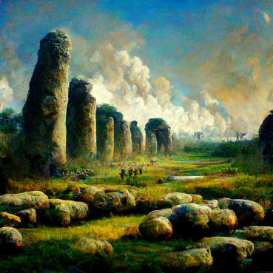

Slide 27
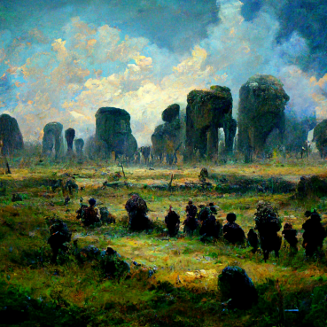

Slide 28
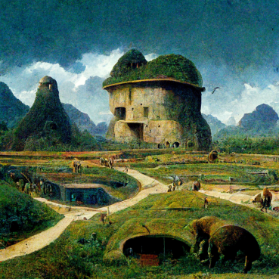

Slide 29
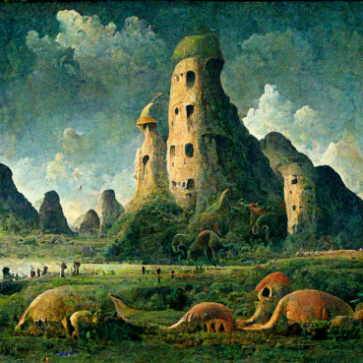

Slide 30
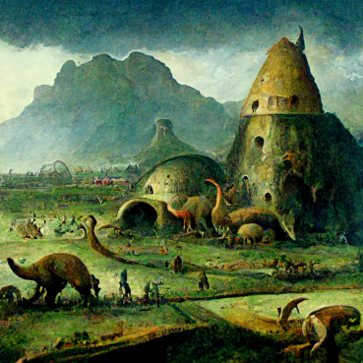

Slide 31
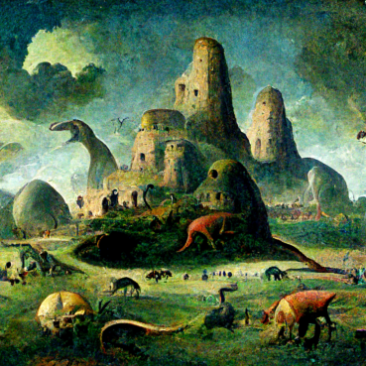

Slide 32
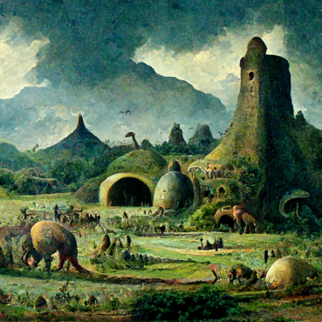

Slide 33
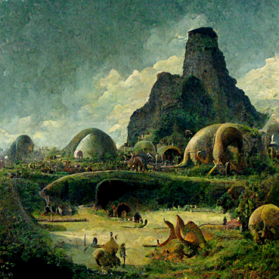

Slide 34
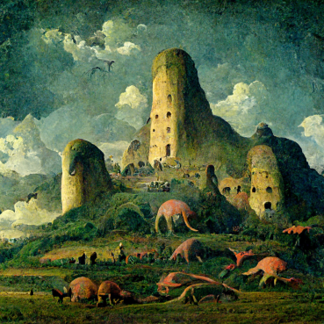

Slide 35
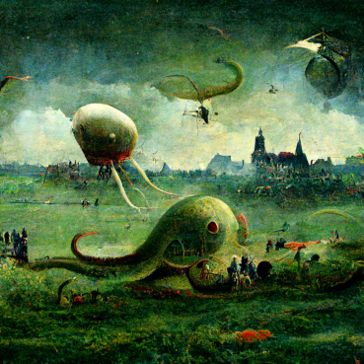

Slide 36
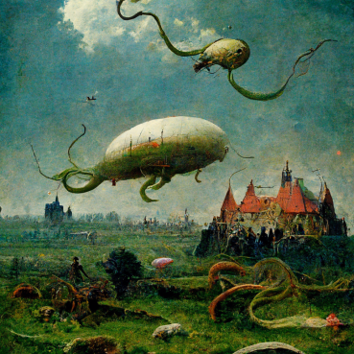

Slide 37
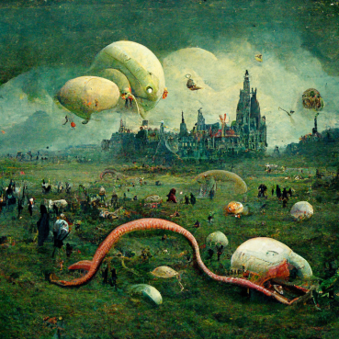

Slide 38
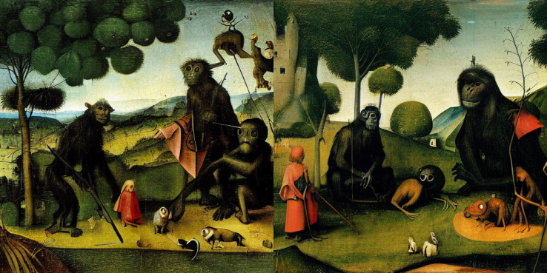

Slide 39
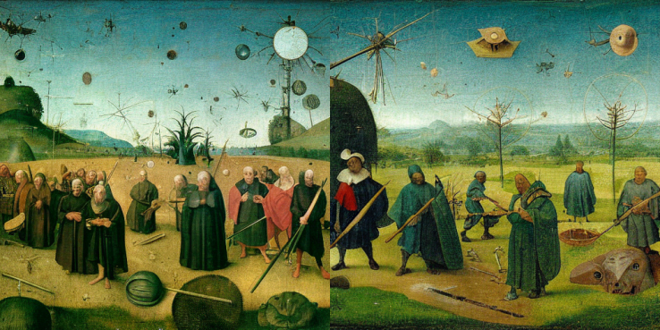

Slide 40
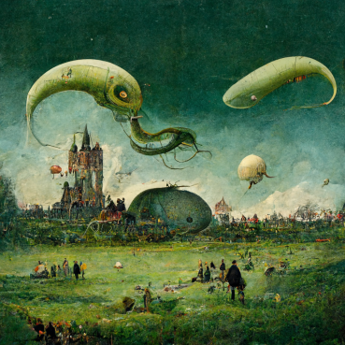

Slide 41
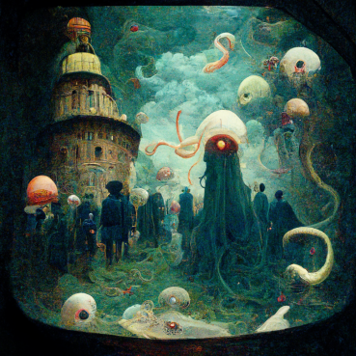

Slide 42
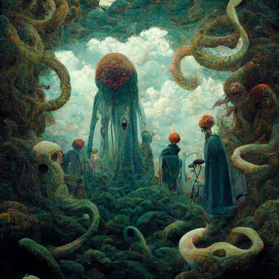

Slide 43
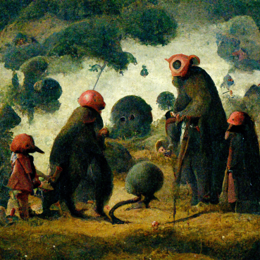

Slide 44
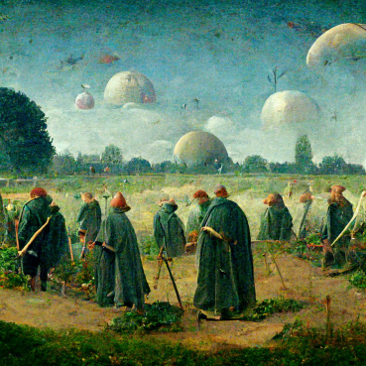

Slide 45
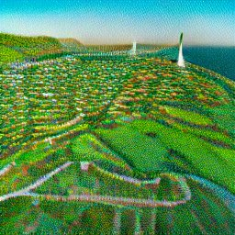

Slide 46
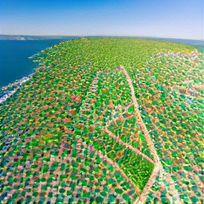

Slide 47
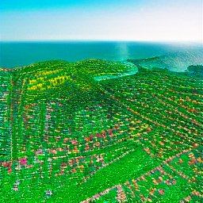

Slide 48
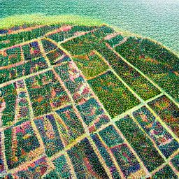

Slide 49
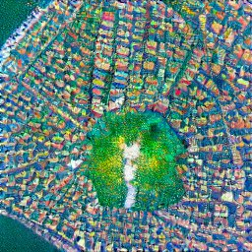

Slide 50
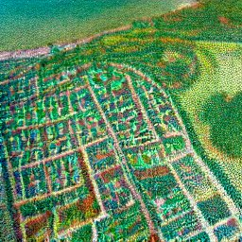

Slide 51


Slide 52


Slide 53


Slide 54


Slide 55


Slide 56


Slide 57


Slide 58


Slide 59


Slide 60


Slide 61


Slide 62


Slide 63


Slide 64


Slide 65


Slide 66


Slide 67


Slide 68


Slide 69


Slide 71


Slide 72


Slide 73


Slide 74


Slide 75


Slide 76


Slide 77


Slide 78


Slide 79


Slide 80


Slide 81


Slide 82


Slide 83


Slide 84


Slide 85


Slide 86


Slide 87


Slide 88


Slide 89


Slide 90


Slide 91


Slide 92


Slide 93


Slide 94


Slide 95


Slide 96


Slide 97


Slide 98


Slide 99


Slide 100


Slide 101


Slide 102


Slide 103


